Slide 1
Chiba Campaign 2022
Section: Satellite related analyses
Reporter: WU YOU
Date: 2022.11.30

Slide 2
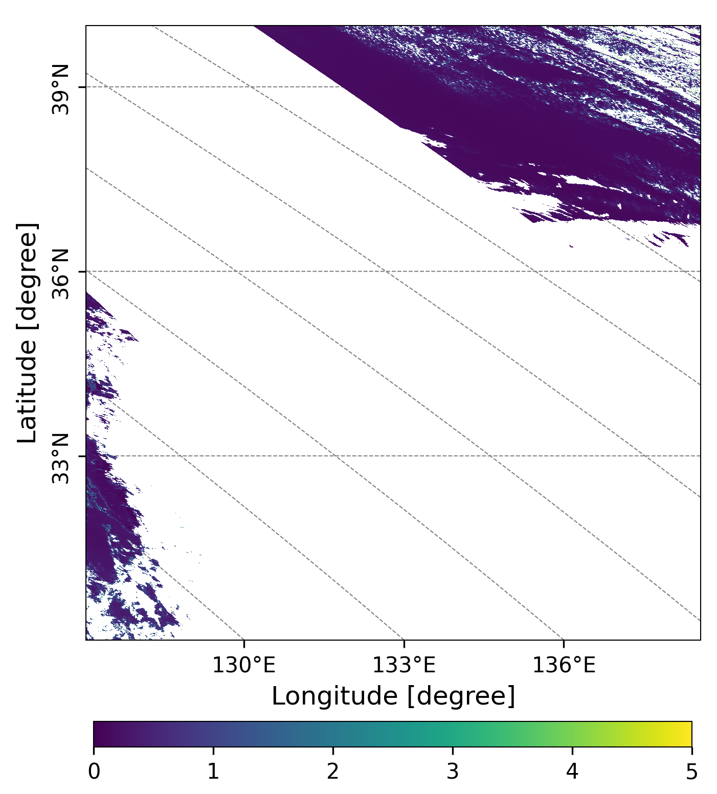
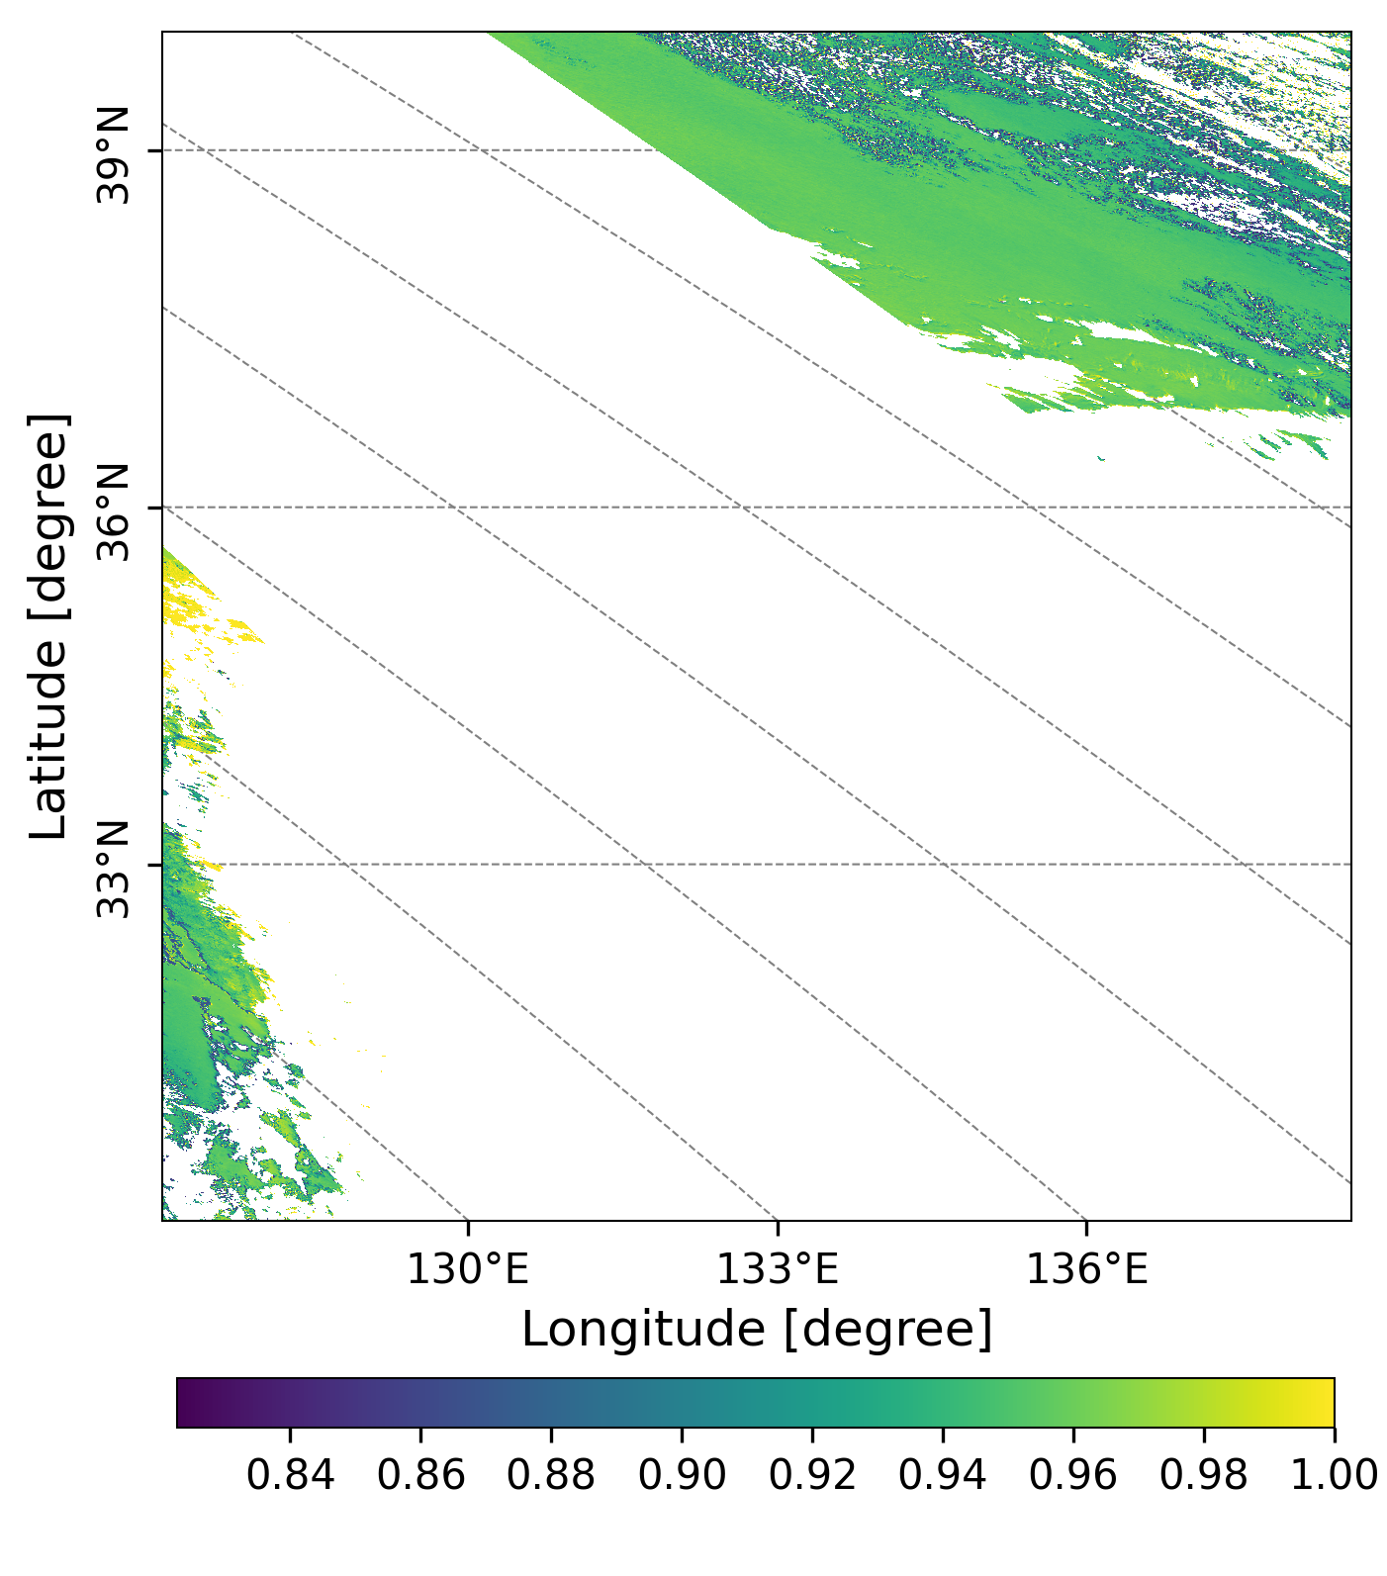
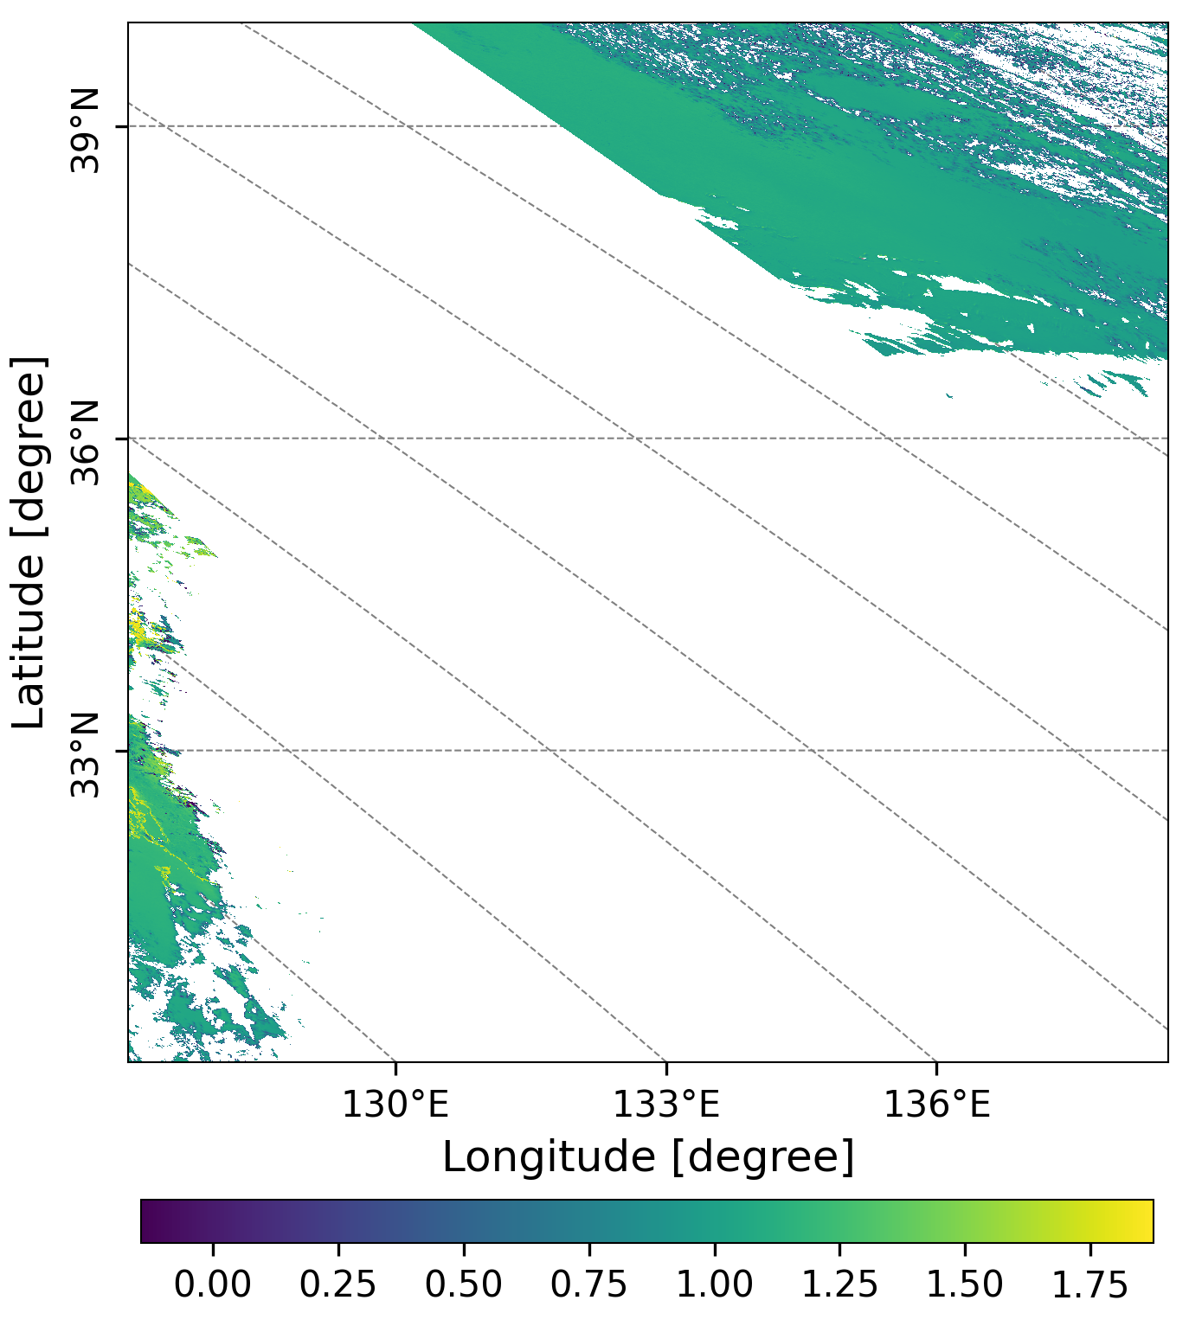
20221128
GC1SG1_20221126D01D_T0529_L2SG_ARNPK_3000.h5
(a)
(b)
(c)
Light-scattering aerosol exits
Figure1. AOD (a) at 500 nm, SSA(b) at 380 nm and AE(c) at 500 and 380 nm over Honshu and Shikoku (本州＋四国)
observed by GCOM-C on Nov.26, Saturday.

Slide 3
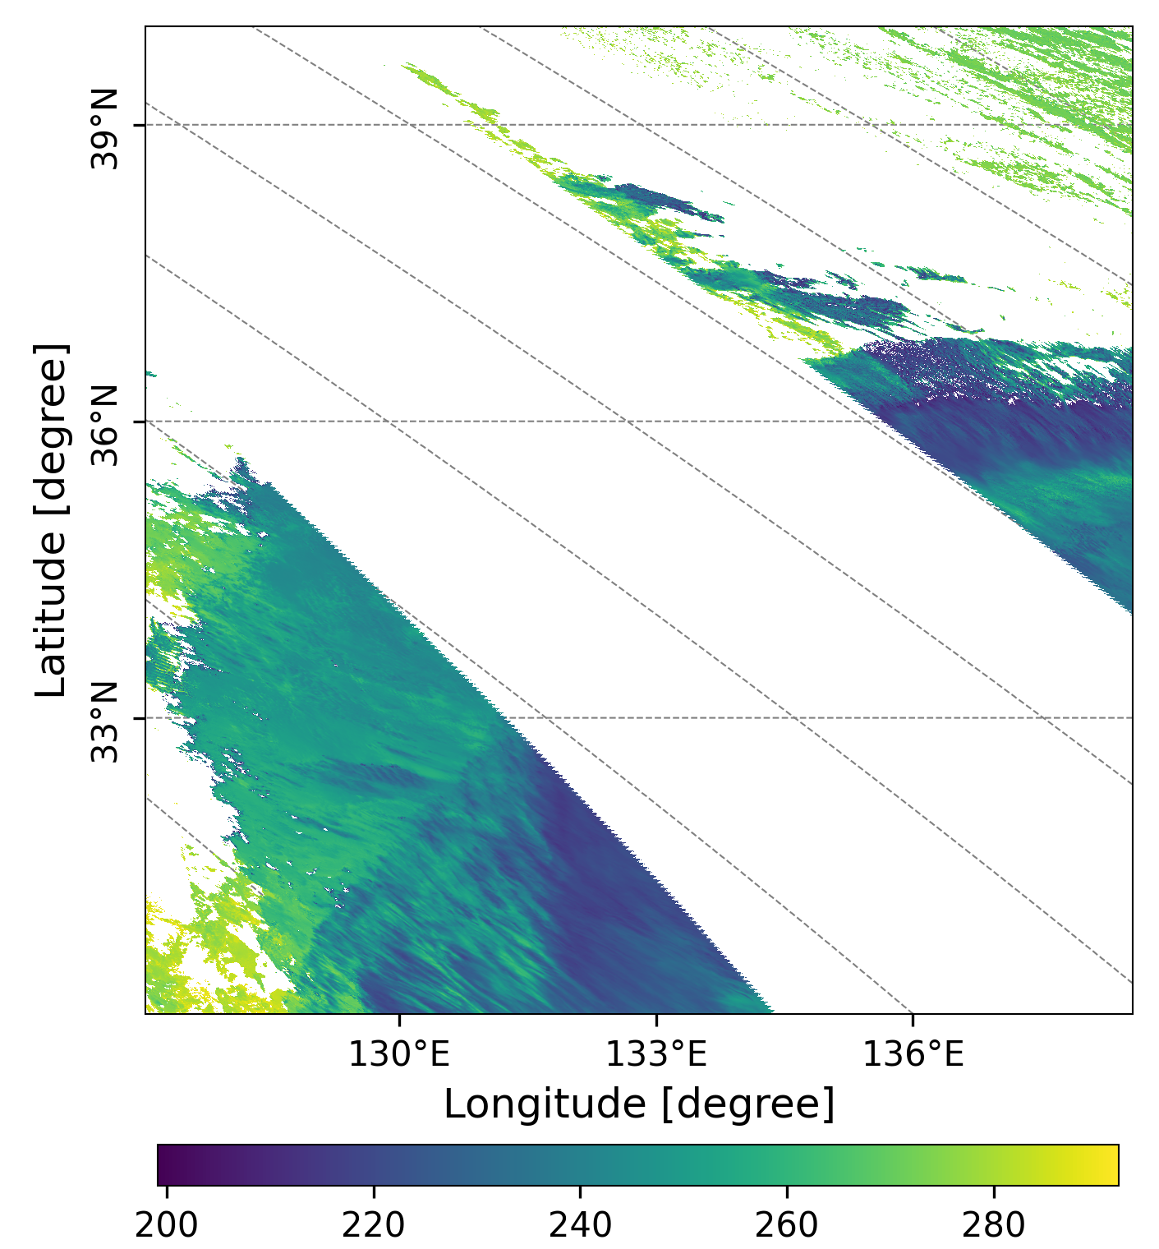
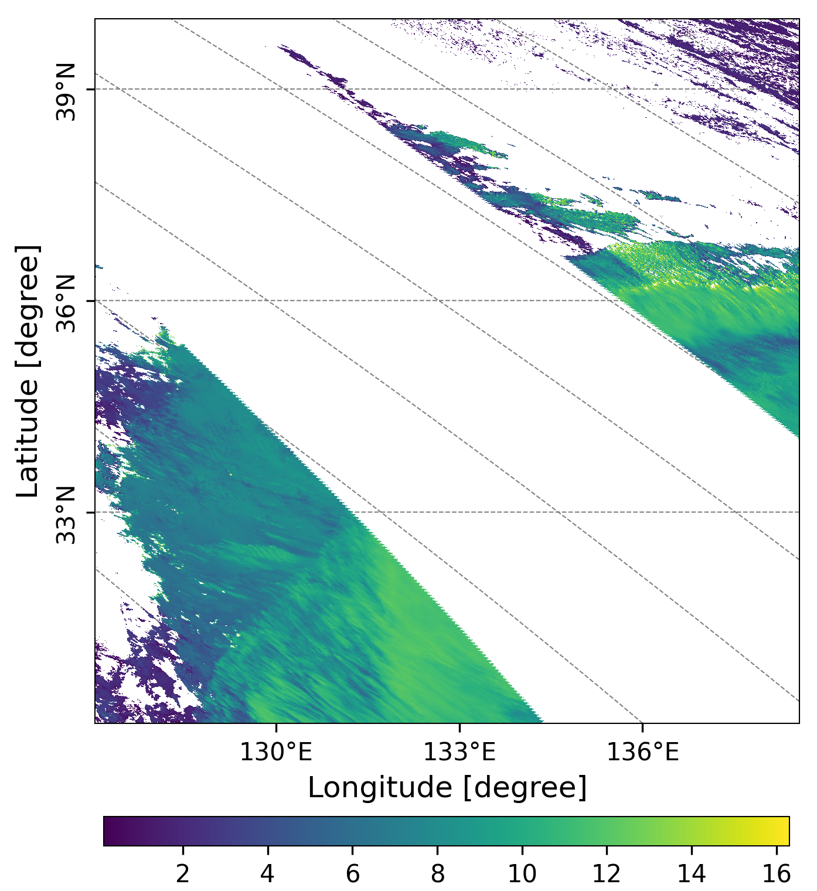
GC1SG1_20221126D01D_T0529_L2SG_CLPRK_3000.h5
(a)
(b)
There was
Figure 2. Cloud Top Temperature (a, Unit: K), and Cloud Top Height (b, Unit: Km) over
Honshu and Shikoku (本州＋四国)observed by GCOM-C.

Slide 4
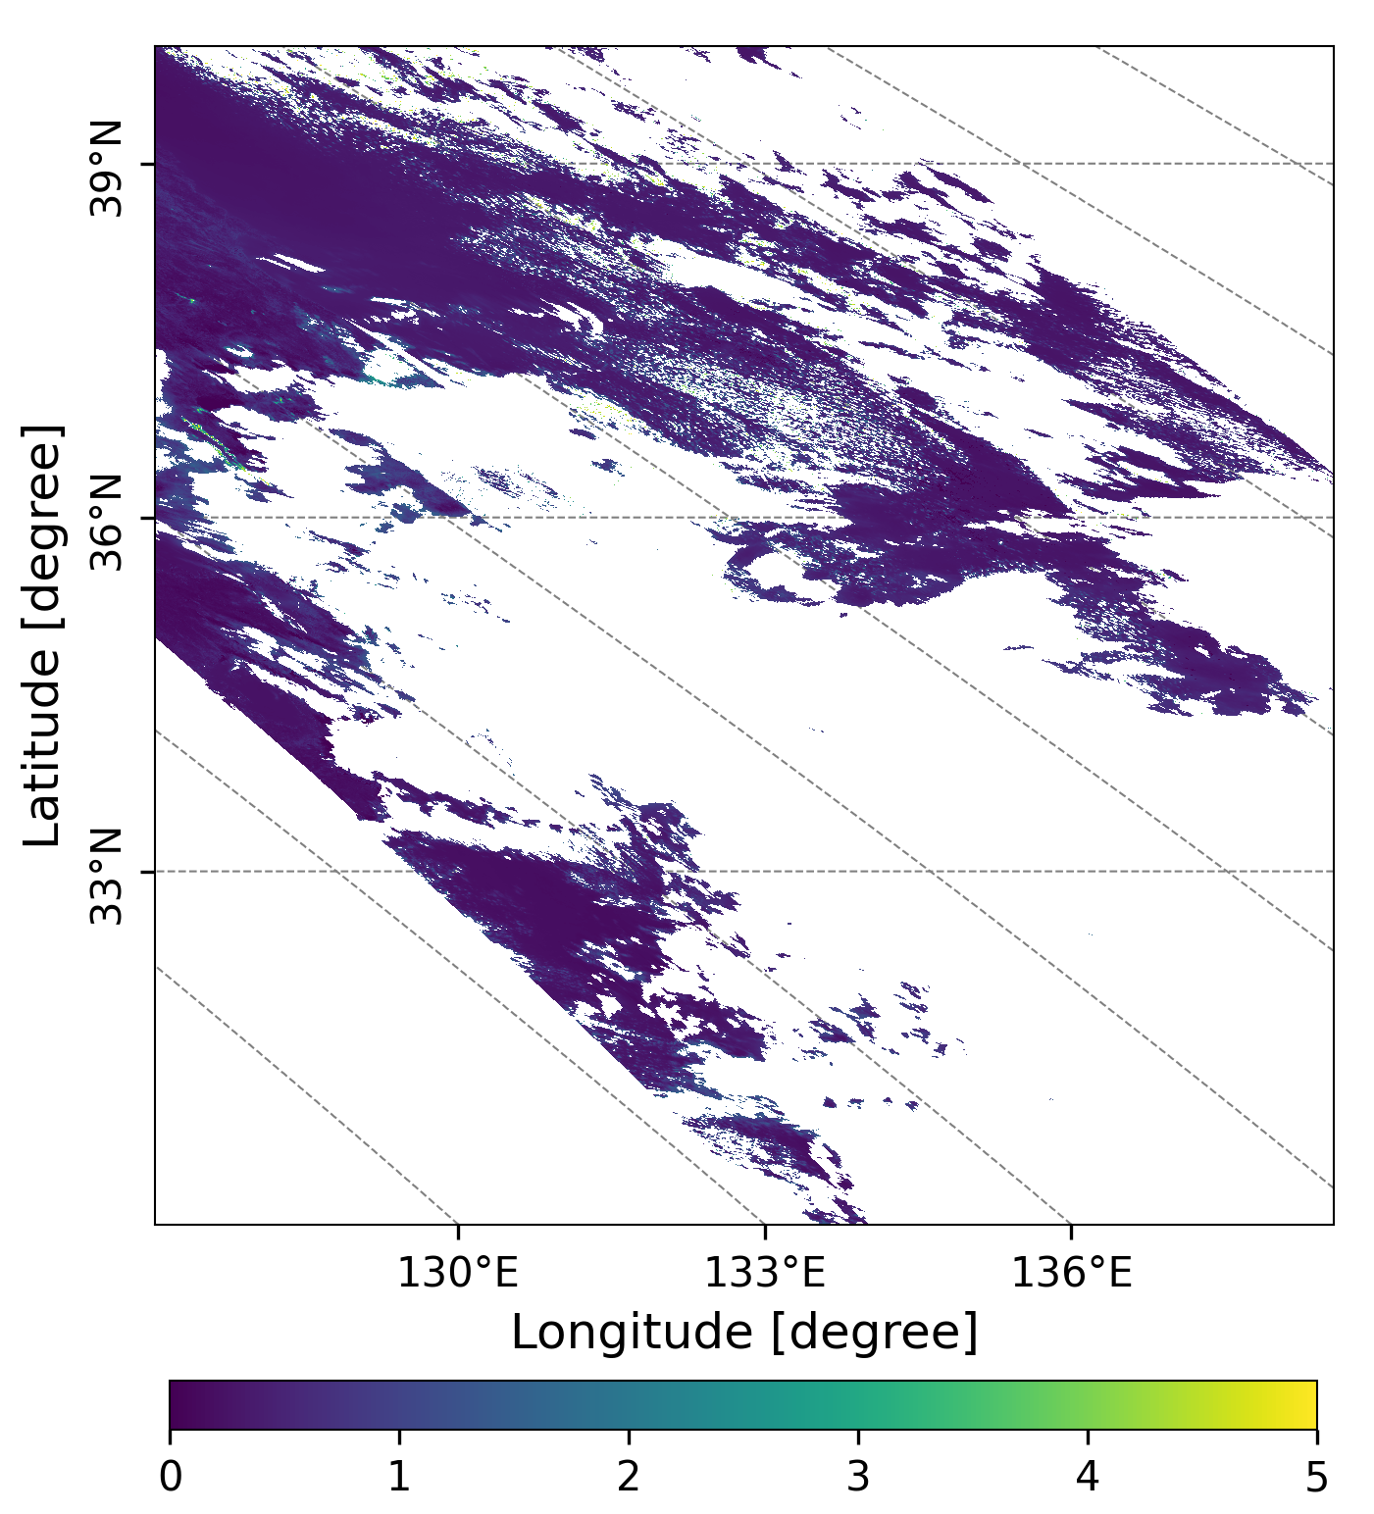
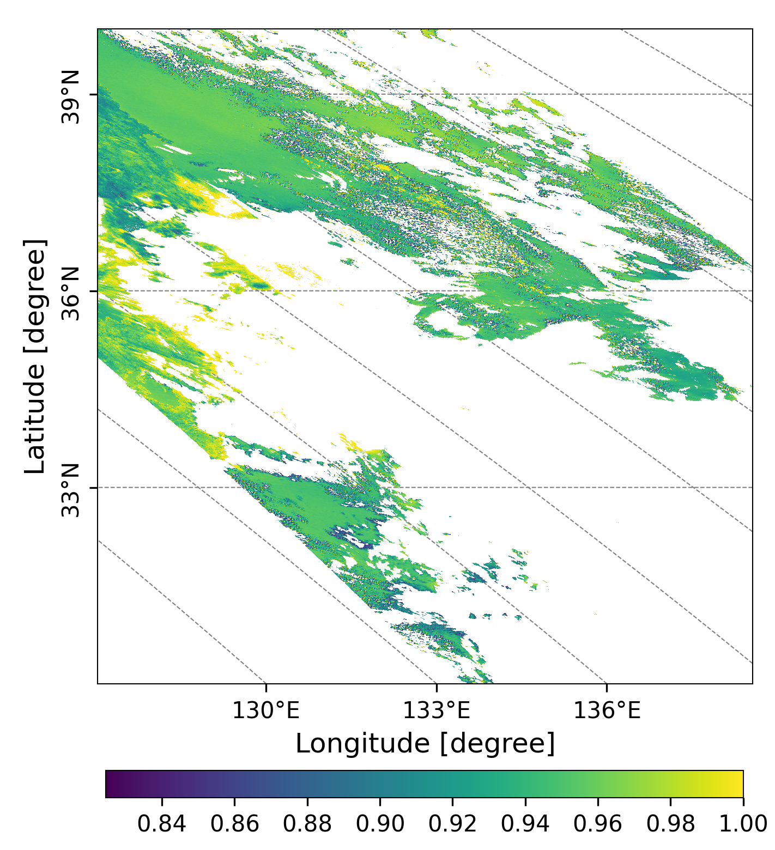
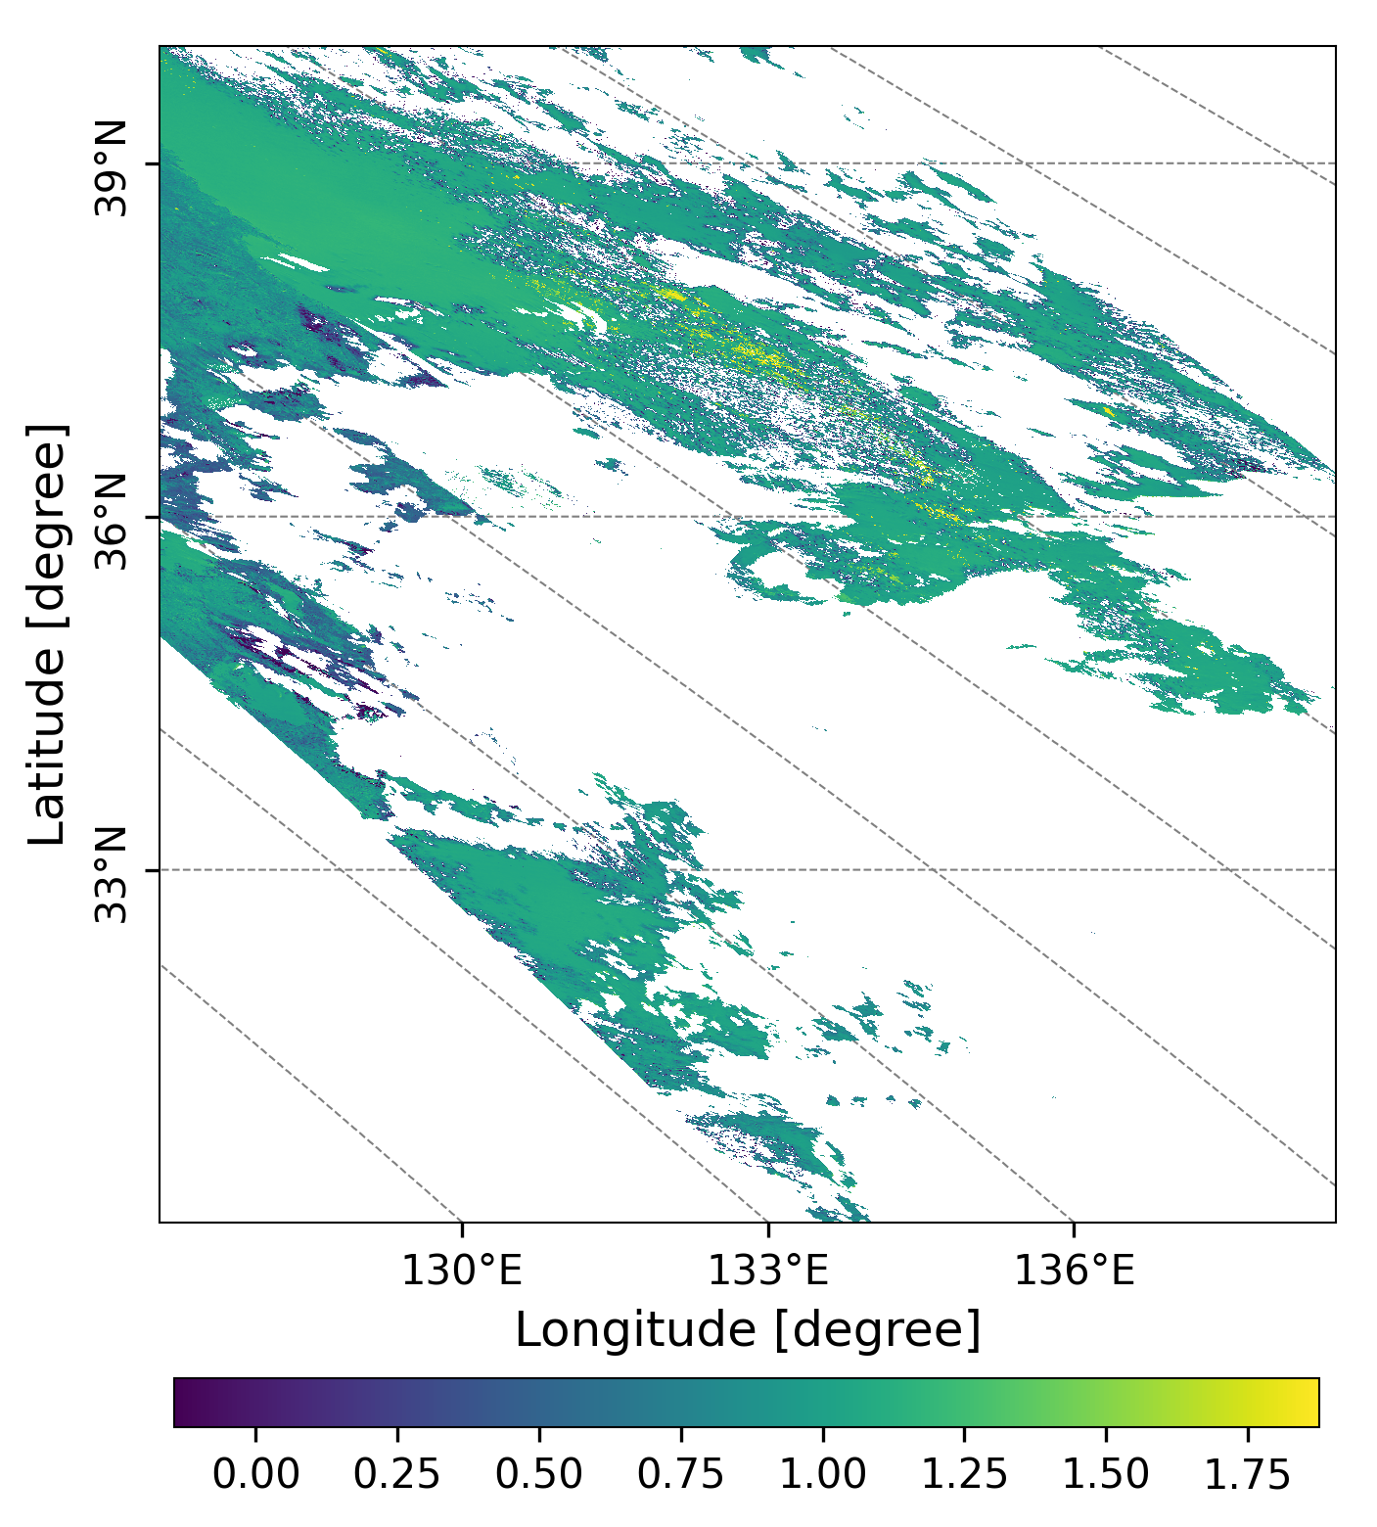
20221129
GC1SG1_20221128D01D_T0529_L2SG_ARNPK_3000.h5
(a)
(b)
(c)
Figure3. AOD (a) at 500 nm, SSA(b) at 380 nm and AE(c) at 500 and 380 nm over Honshu and Shikoku (本州＋四国)observed by GCOM-C on Nov.28, Monday.

Slide 5
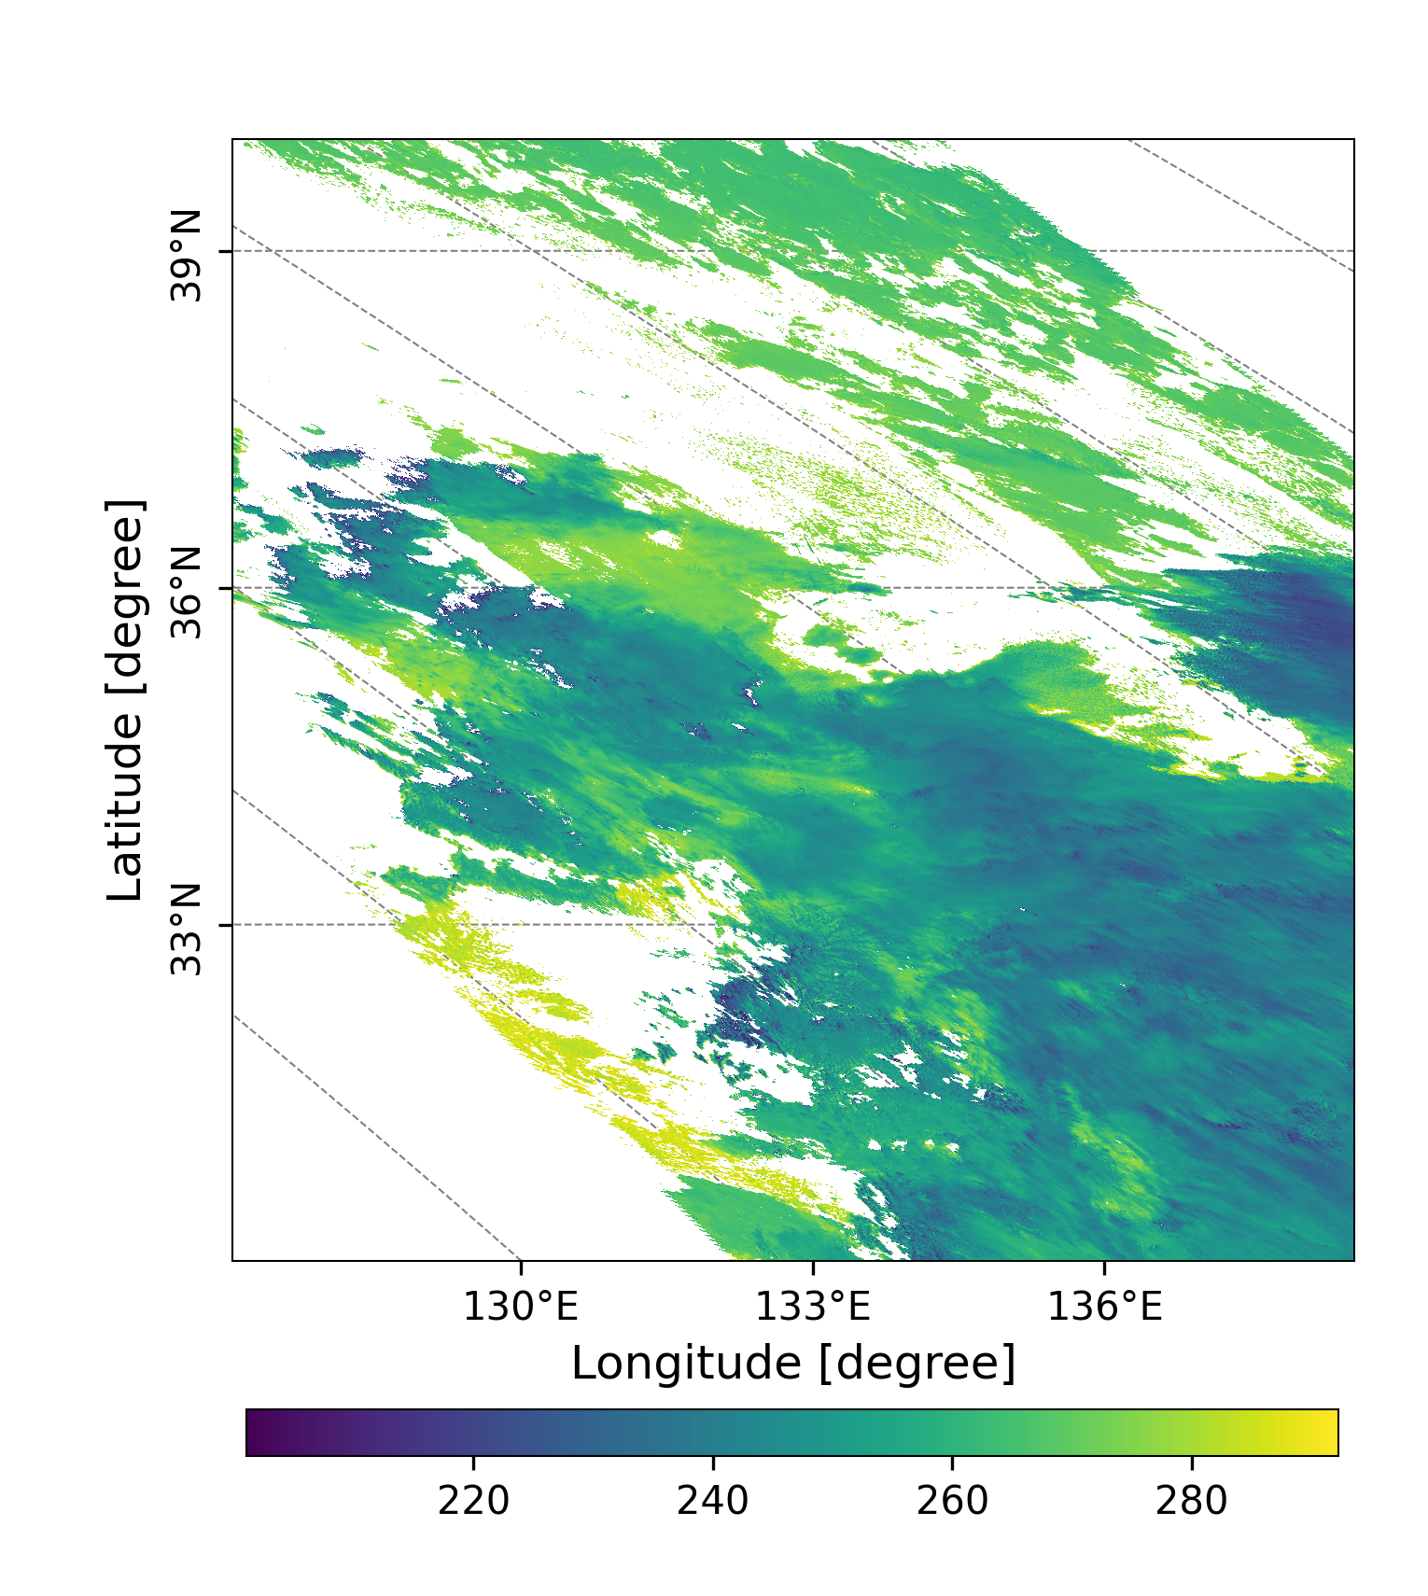
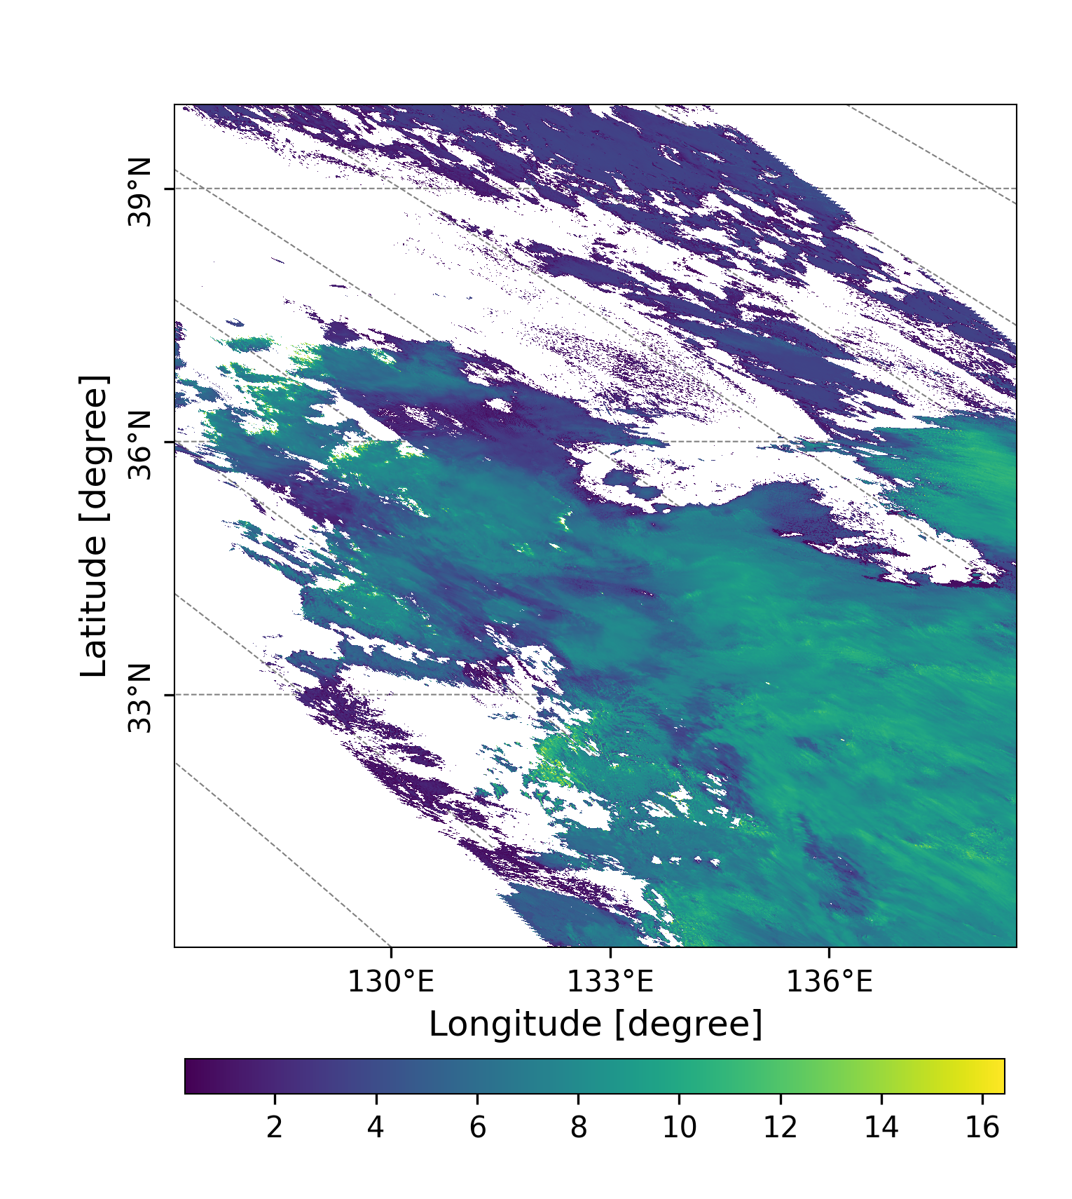
GC1SG1_20221128D01D_T0529_L2SG_CLPRK_3000.h5
(a)
(b)
Figure 4. Cloud Top Temperature (a, Unit: K), and Cloud Top Height (b, Unit: Km) over
Honshu and Shikoku (本州＋四国)observed by GCOM-C on Nov.28, Monday.

Slide 6
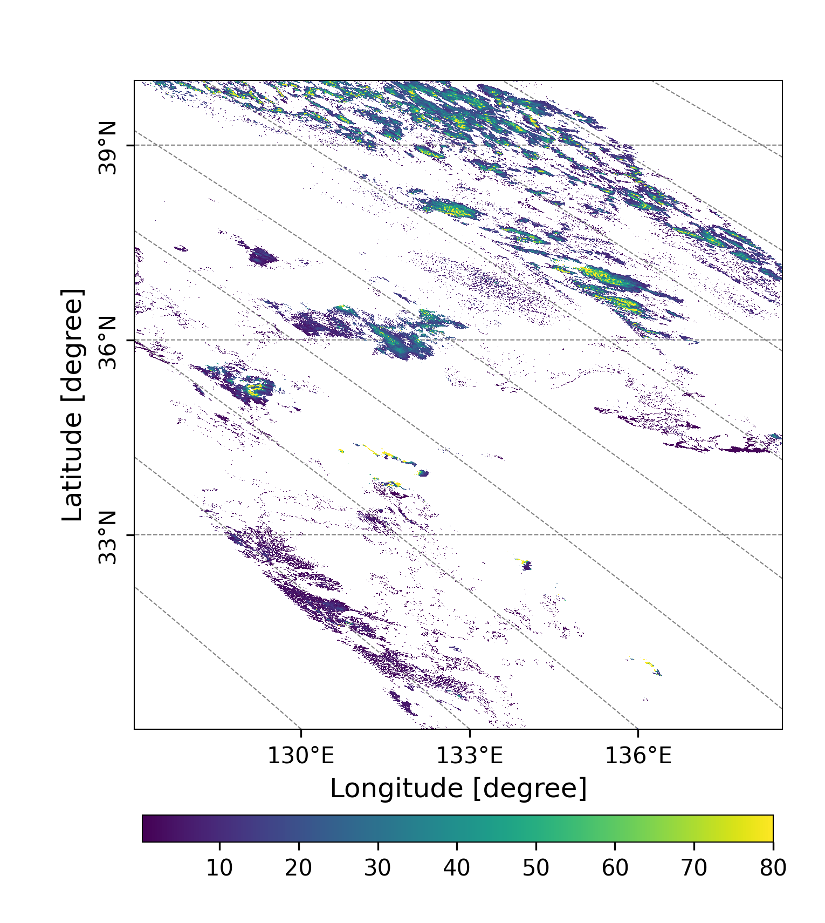
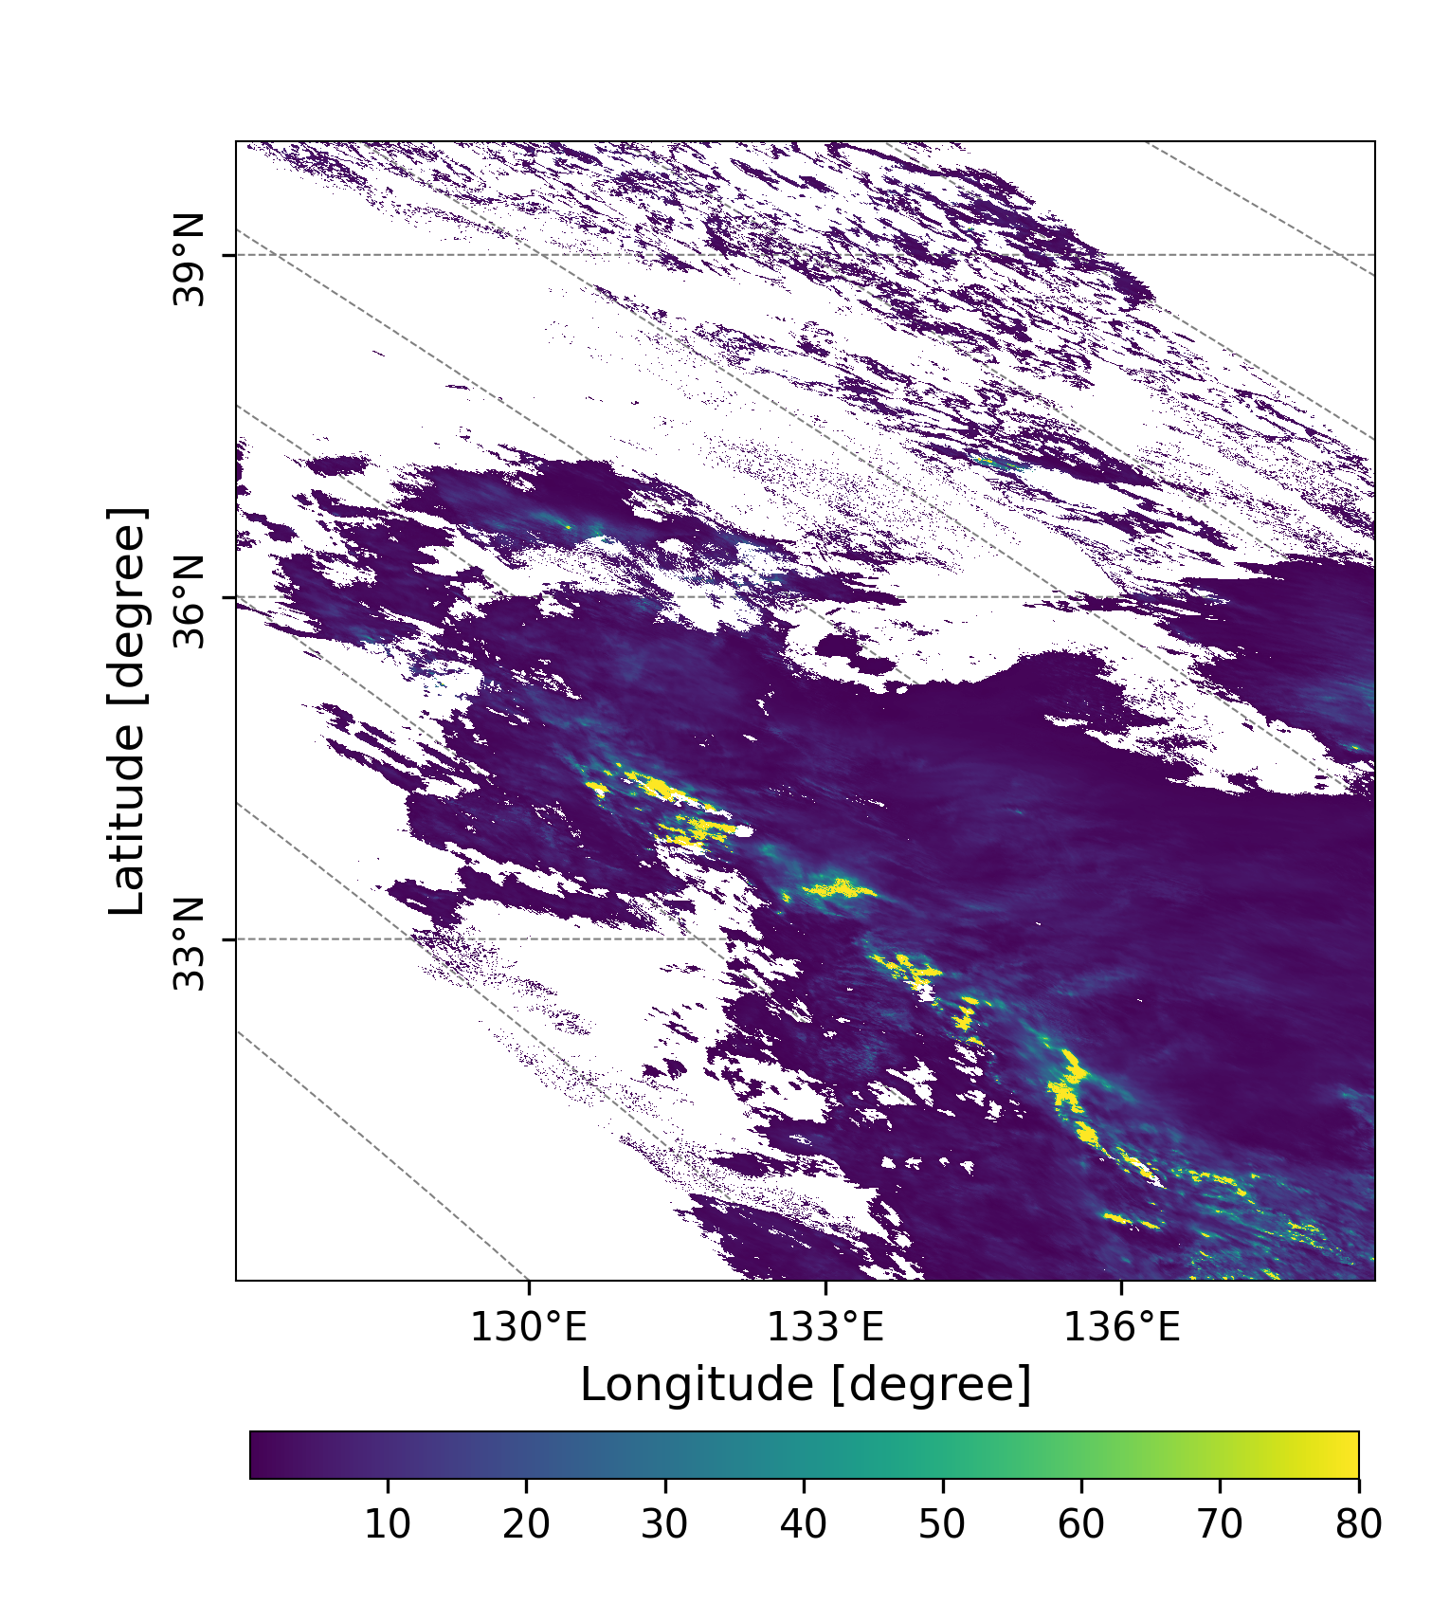
GC1SG1_20221128D01D_T0529_L2SG_CLPRK_3000.h5
(a)
(b)
high and thin
cloud (cirrus)
exists.
Figure 5. Liquid water cloud optical thickness(a), and ice cloud optical thickness (b) over Honshu and Shikoku (本州＋四国)observed by GCOM-C on Nov.28, Monday.

Slide 7
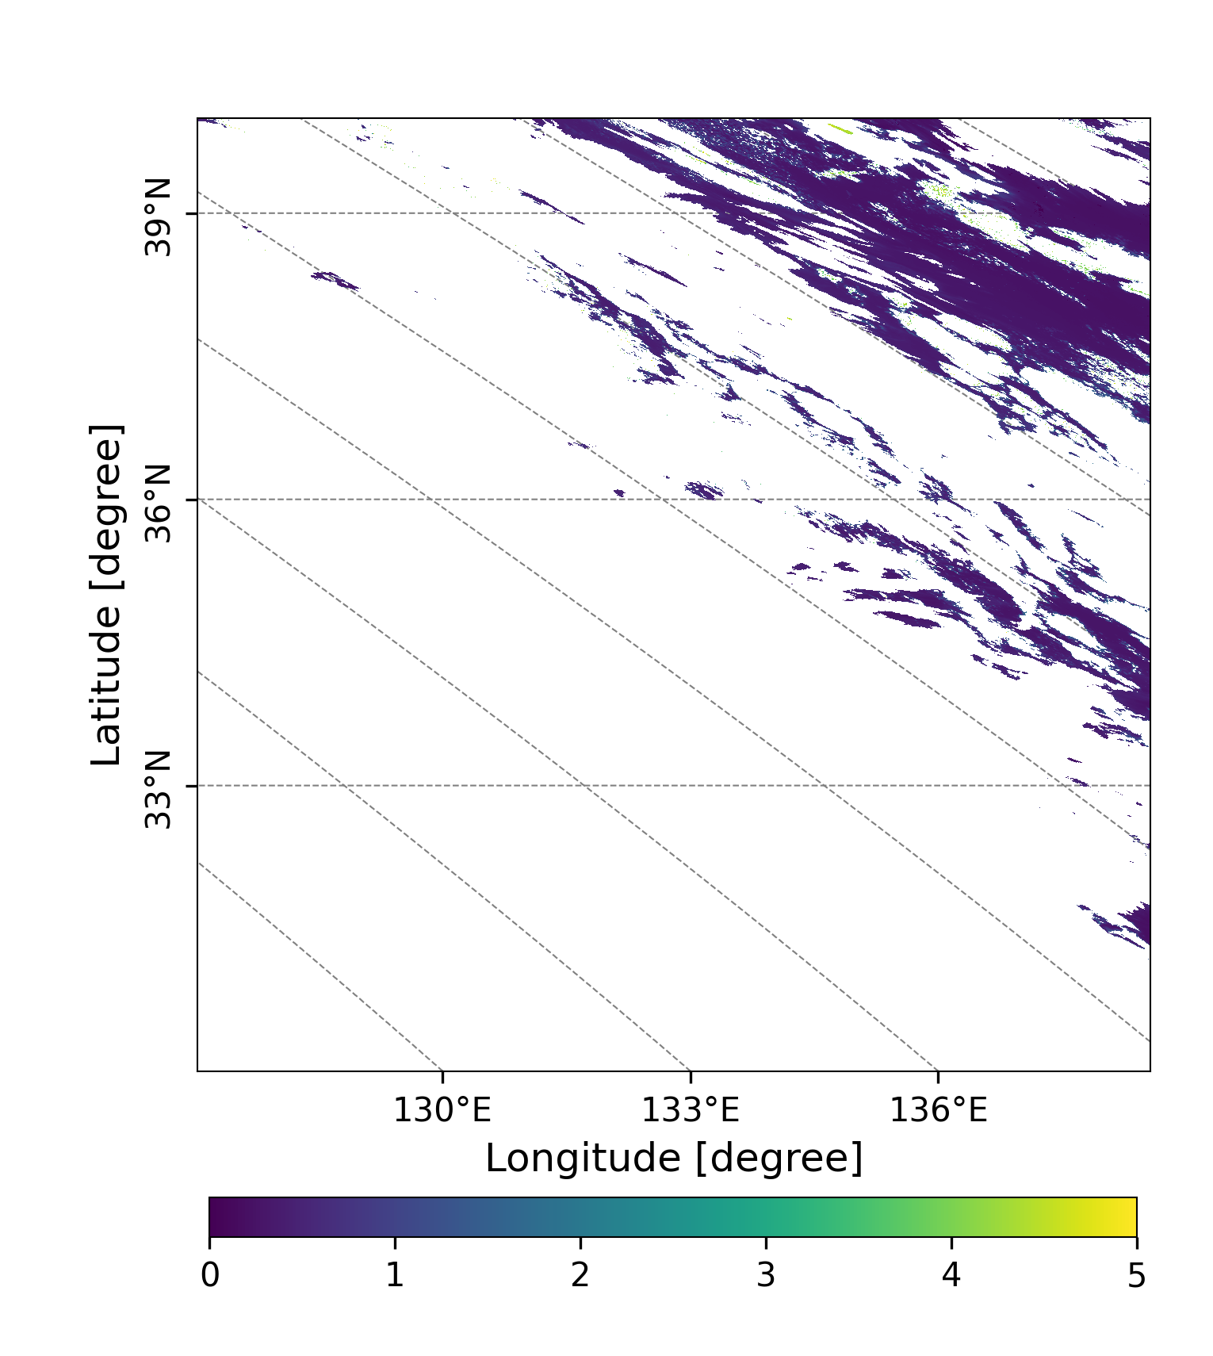
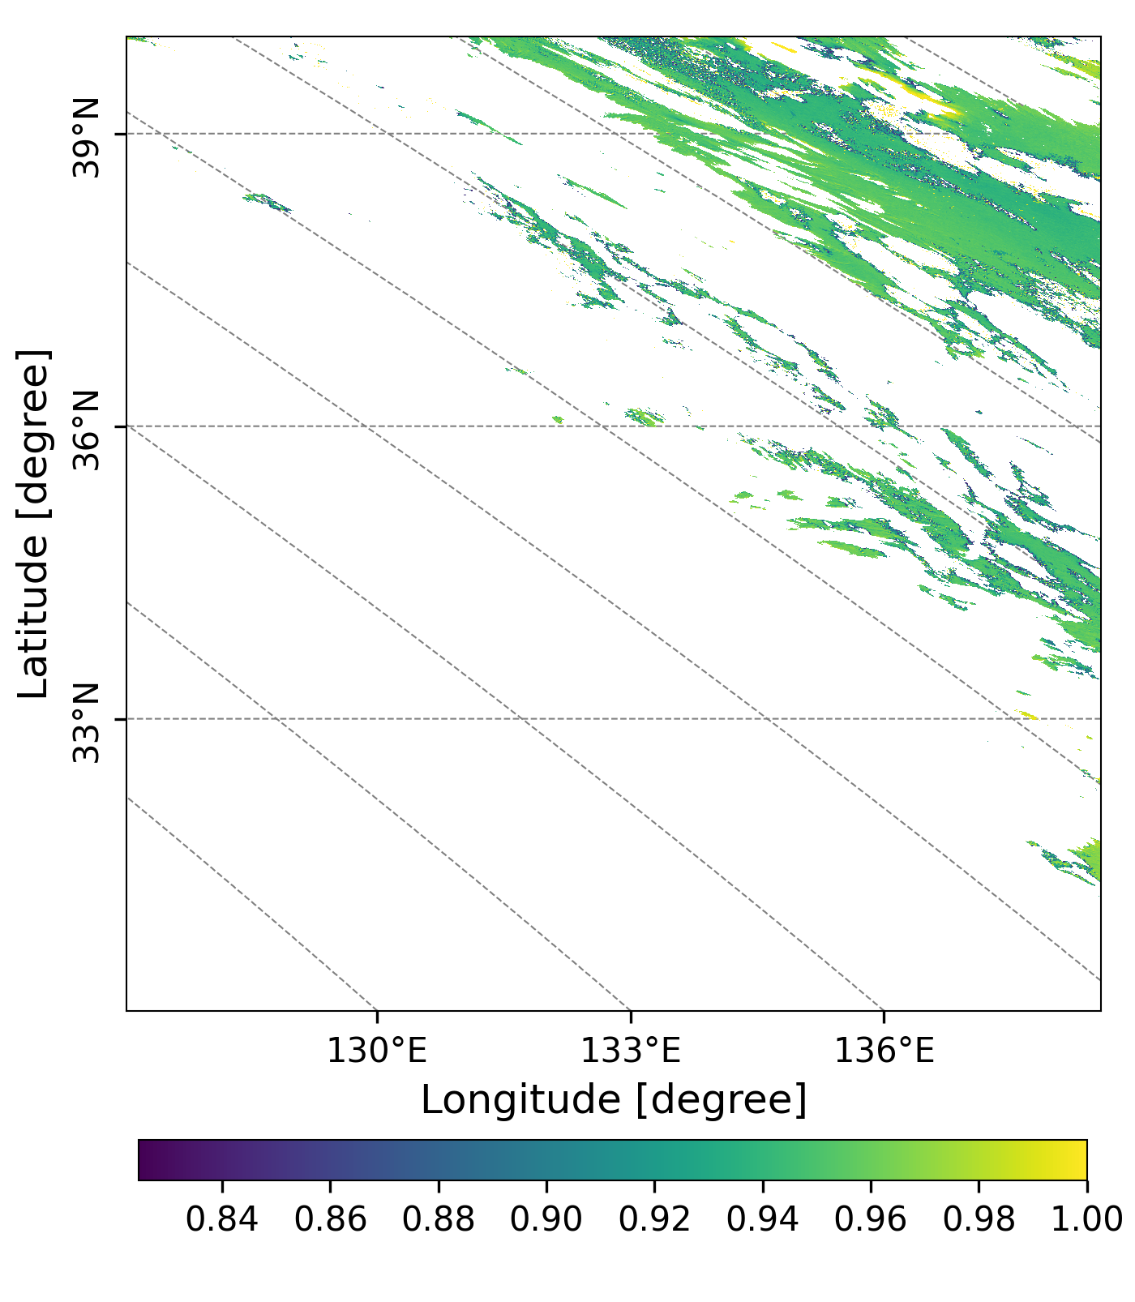
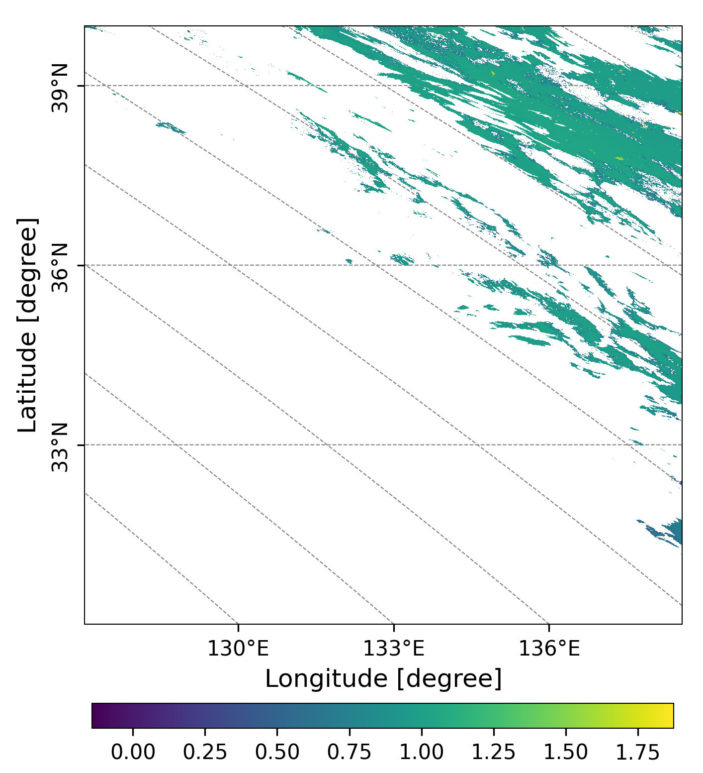
20221130
GC1SG1_20221129D01D_T0529_L2SG_ARNPK_3004.h5
(a)
(b)
(c)
Figure6. AOD (a) at 500 nm, SSA(b) at 380 nm and AE(c) at 500 and 380 nm over Honshu and Shikoku (本州＋四国)observed by GCOM-C on Nov.29, Tuesday.

Slide 8
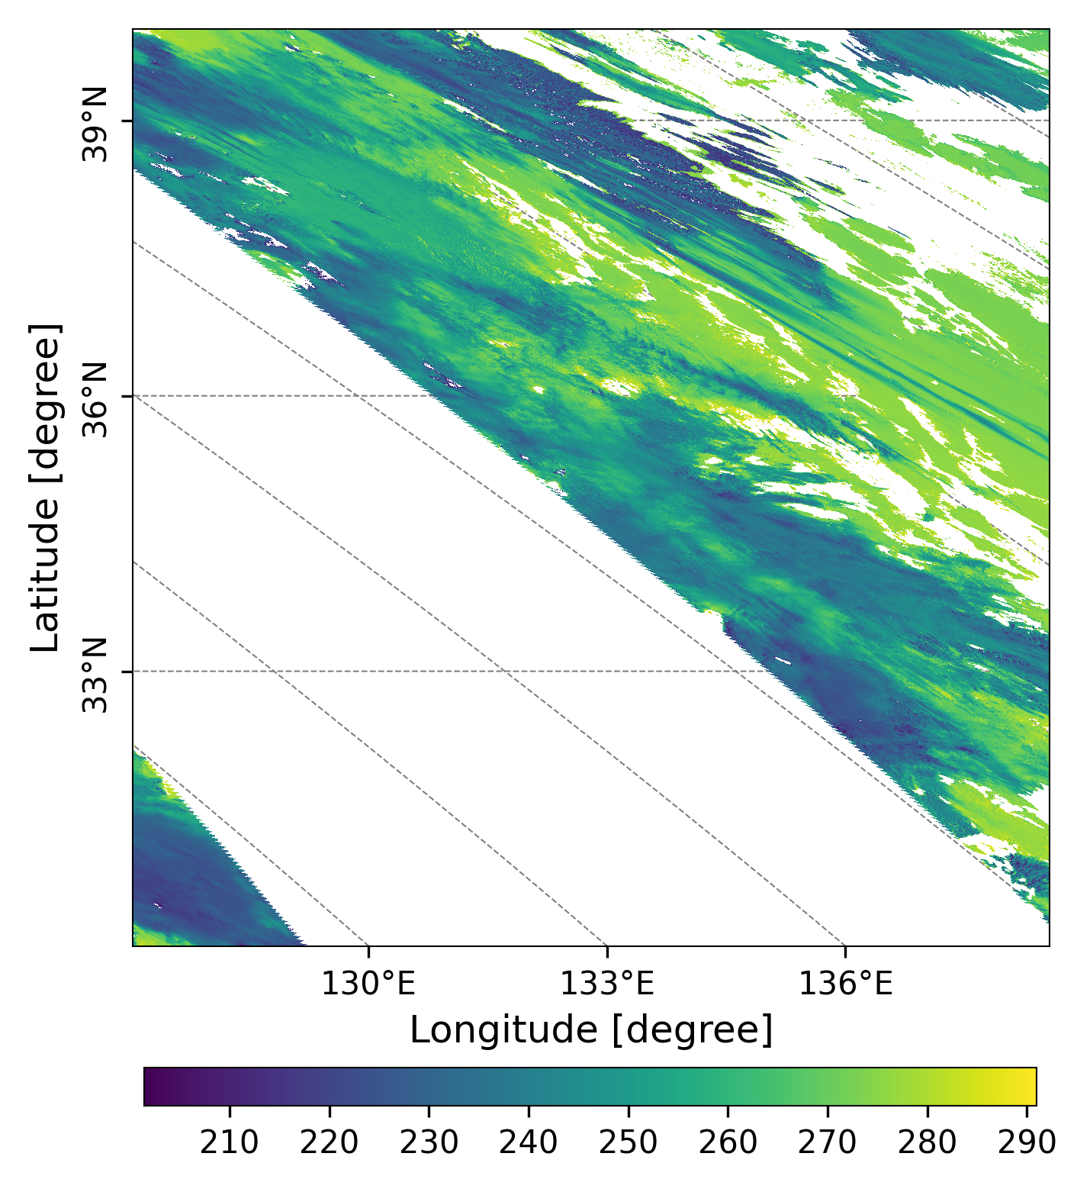
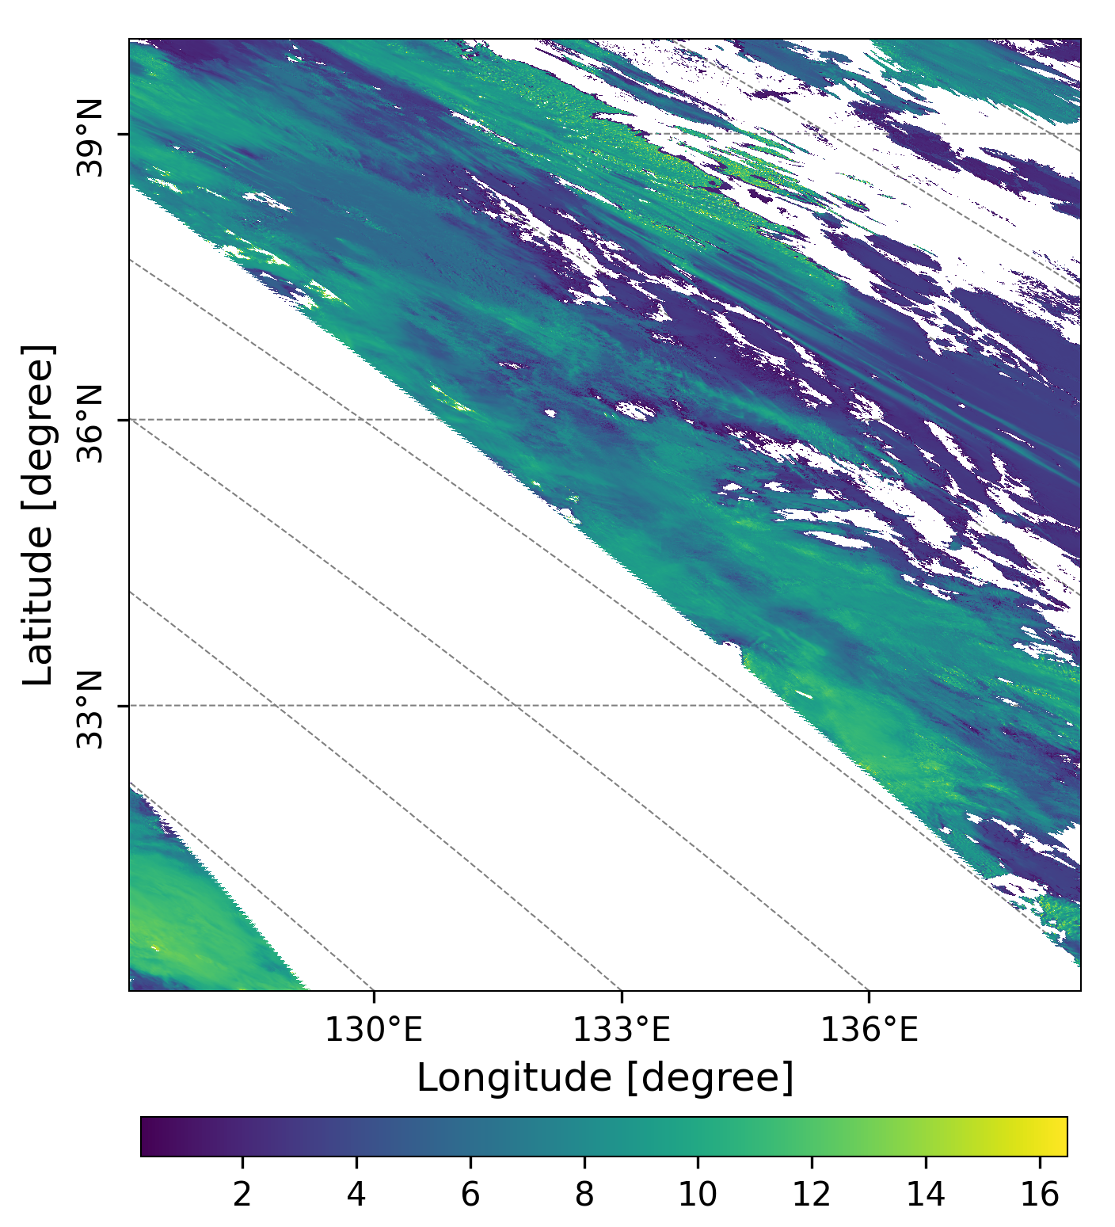
GC1SG1_20221129D01D_T0529_L2SG_CLPRK_3000.h5
Figure 7. Cloud Top Temperature (a, Unit: K), and Cloud Top Height (b, Unit: Km) over Honshu and Shikoku (本州＋四国)observed by GCOM-C on Nov.29, Tuesday.

Slide 9
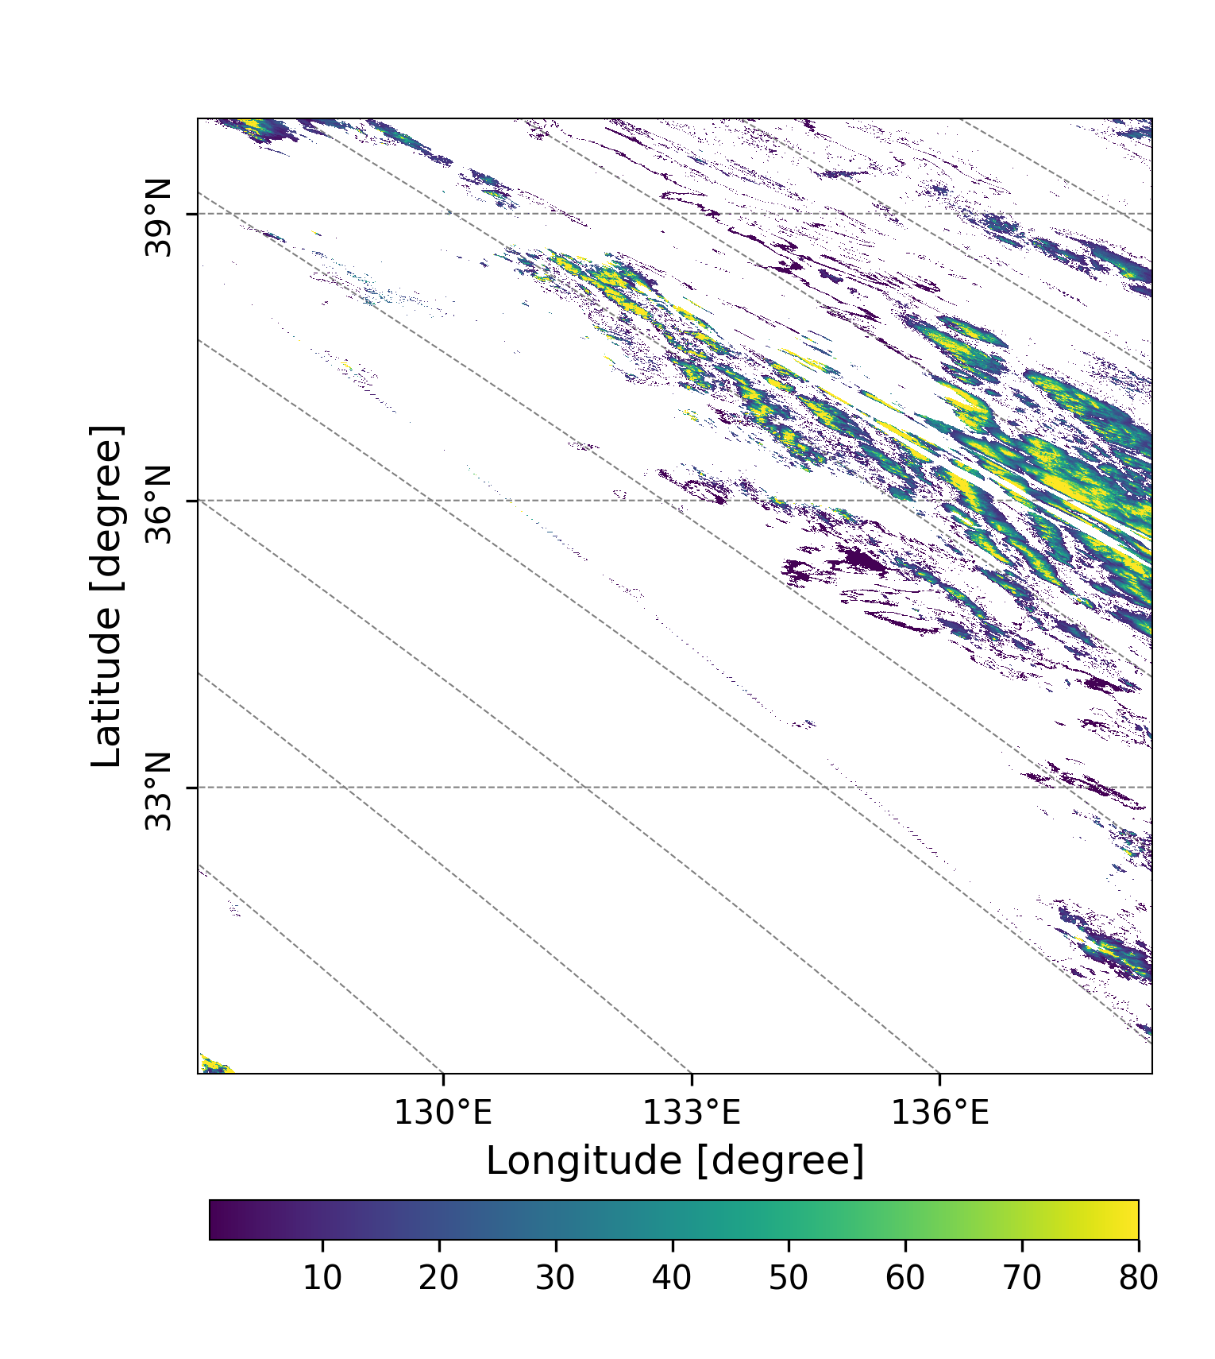
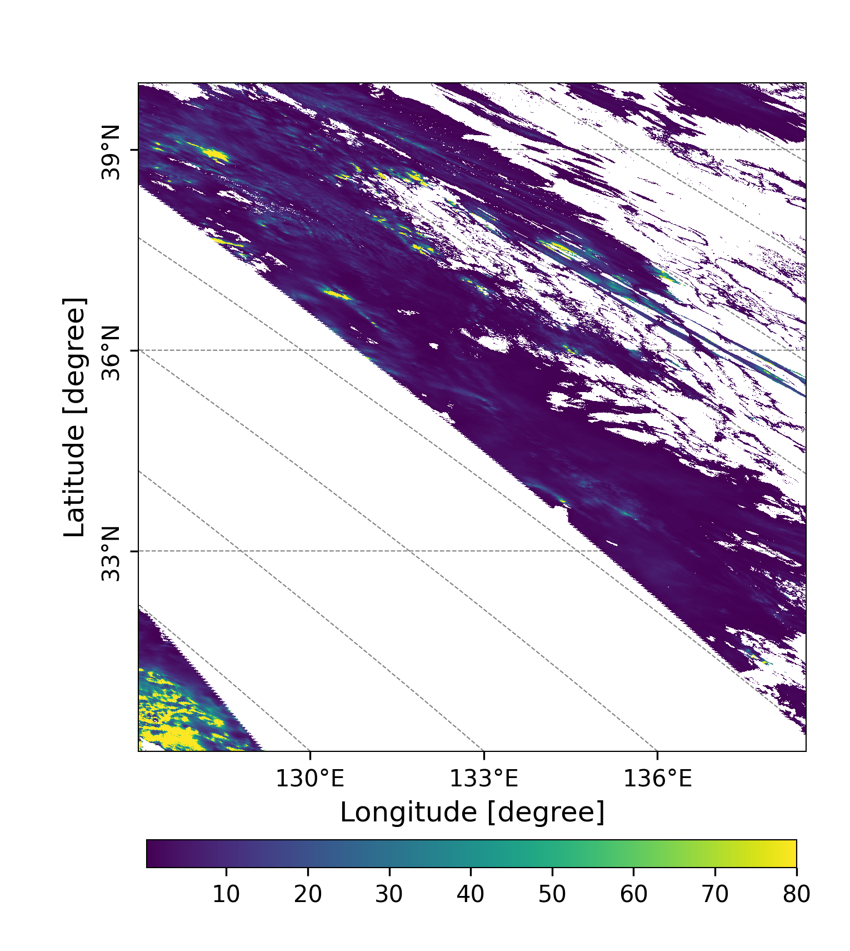
GC1SG1_20221129D01D_T0529_L2SG_CLPRK_3000.h5
(a)
(b)
airplane trail cloud?
Figure 8. Liquid water cloud optical thickness(a), and ice cloud optical thickness (b) over Honshu and Shikoku (本州＋四国)observed by GCOM-C on Nov.29, Tuesday.

